Slide 1

1
Health Expenditure & Mortality Rates :
A Correlation Analysis in Developing Countries
Muneeba, Eeshal, Samah, Shifa

Slide 2
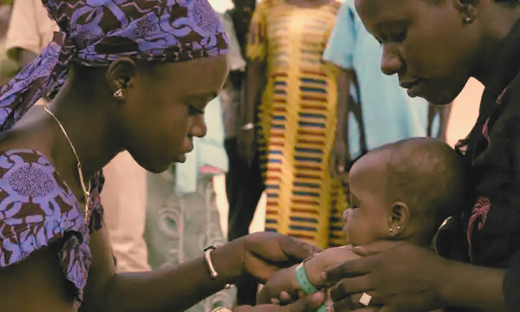
2
INTRODUCTION
LITERATURE REVIEW
CONTENTS
METHODOLOGY
DATA ANALYSIS
CONCLUSION
REFERENCES

Slide 3

3
RESEARCH QUESTION
Is there a correlation between infant mortality rates, life expectancy and health expenditure as a percentage of GDP in least developed countries over time?

Slide 4

4
LITERATURE REVIEW
Negative correlation between increase in public health expenditure and infant and adult mortality rate
1% increase in public health care expenditure significantly reduces under-five mortality by between 0.25%-0.42%, and maternal mortality by 0.42–0.52% [13]

Slide 5
5
HYPOTHESIS
There is an inverse correlation between mortality rate and health expenditure.

Slide 6

6
METHODOLOGY

Slide 7

7
Data Source
Period: 2000 to 2023.
Coverage: 46 Least Developed Countries (LDCs). [14]
Data Source: World Bank Open Data (World Databank website)
Economic Indicators:
GDP growth (annual %).
GDP (current US$).
Health Indicators:
Current health expenditure (% of GDP).
Life expectancy at birth (years).
Infant mortality rate (IMR, per 1,000 live births).

Slide 8
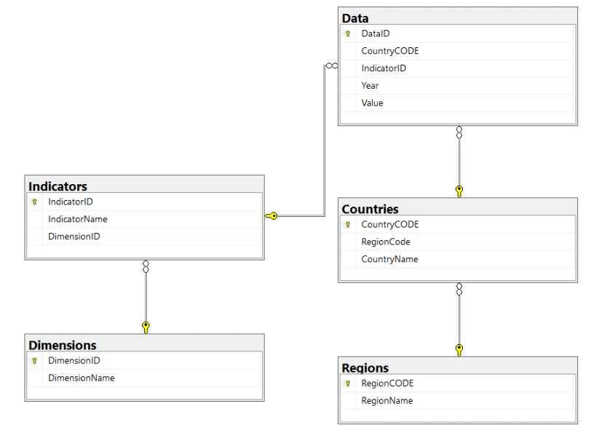
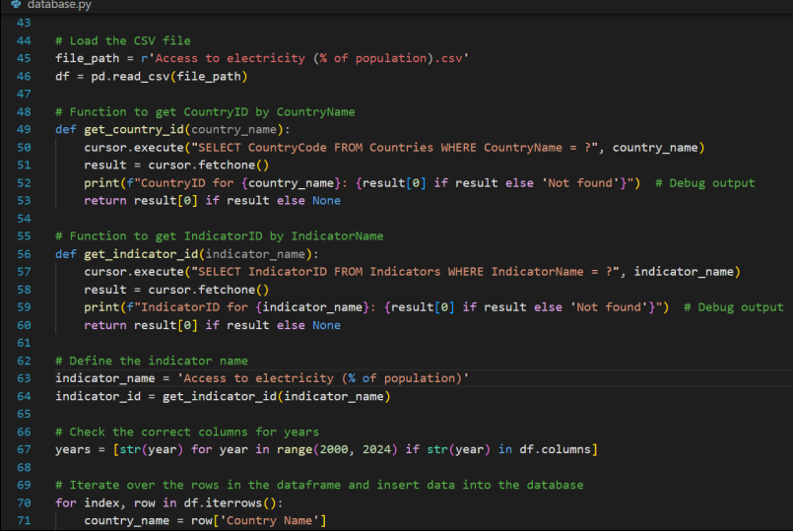
8
Data Processing
Data Cleaning:
Handled missing values and inconsistencies.
Ensured uniform formatting.
Data Integration:
Consolidated into an MSSQL database with tables for regions, subregions, countries, dimensions, indicators, and data values.
Python scripts were used for automation and consistency.

Slide 9
9
Data Analysis
Visualization and Trend Analysis:
Tools Used: Power BI for dynamic and interactive visualizations.
Visualizations Created:
Line charts for tracking longitudinal changes (e.g., IMR, life expectancy).
Mixed bar and line charts for yearly trends across selected regions.

Slide 10
10
Data Analysis
Descriptive Statistics:
Mean values calculated across all indicators (ignoring regional/time-specific variations).
Power BI DAX (Data Analysis Expressions) for computing averages (e.g., IMR, life expectancy).

Slide 11
11
Data Analysis
Correlation Analysis:
Generated Using Python: Heatmaps (via Pandas, Seaborn, and Matplotlib) to explore correlations.
Power BI: Line charts to visualize evolving correlations over time.
Objective: Identify relationships between health expenditures and outcomes.

Slide 12
12
Data Analysis
Efficiency and Scalability:
Python for data cleaning ensures robust handling of large datasets.
SQL database structure supports seamless multi-country, multi-indicator analysis.
Dynamic Visualizations:
Power BI facilitates interactive and real-time exploration of trends.

Slide 13
13
Data Analysis
Comprehensive Insights:
Longitudinal and regional comparisons provide both temporal and spatial analysis.
Statistical Rigor:
Correlation analysis validates hypotheses.
Descriptive statistics summarize high-level trends for actionable insights.

Slide 14

14
RESULTS AND DISCUSSION

Slide 15
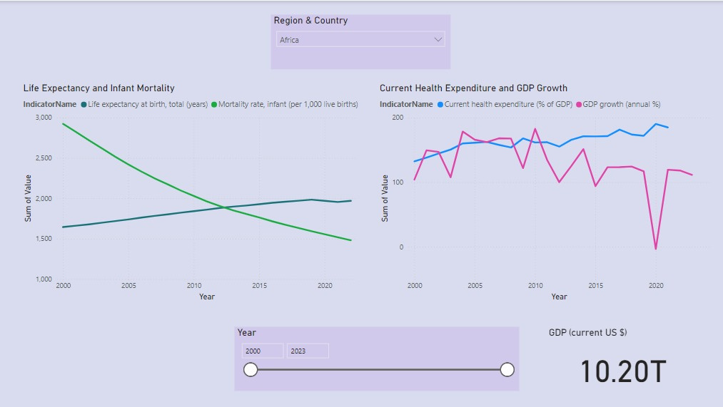
Africa
15
Infant Mortality: Significant decline in recent years.
Health Expenditure: Stable at start but increases slightly in recent years.
Correlation: Small health spending increases have significantly reduced mortality rates and improved life expectancy.

Slide 16
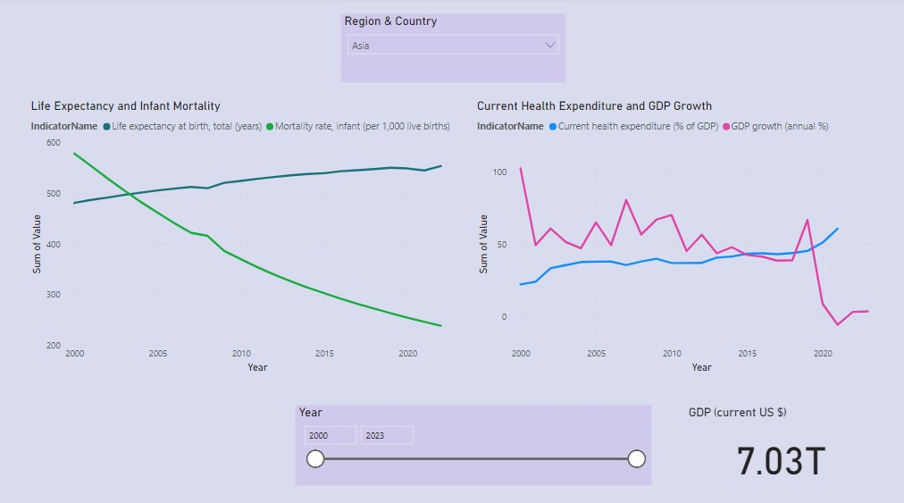
Asia
16
Infant Mortality: Consistent decline over the years.
Health Expenditure: Increases slightly over time, though not drastically.
Correlation: Minimal increases in health funding improve mortality rates.

Slide 17
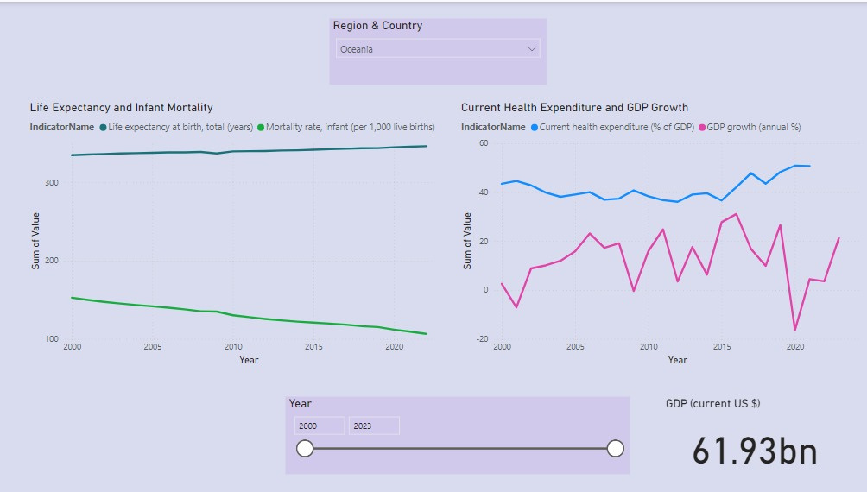
17
Oceania
Infant Mortality: Gradual decline in recent years.
Health Expenditure: Modest upward trend.
Correlation: Increased health expenditure is strongly linked to lower mortality rates and higher life expectancy.

Slide 18
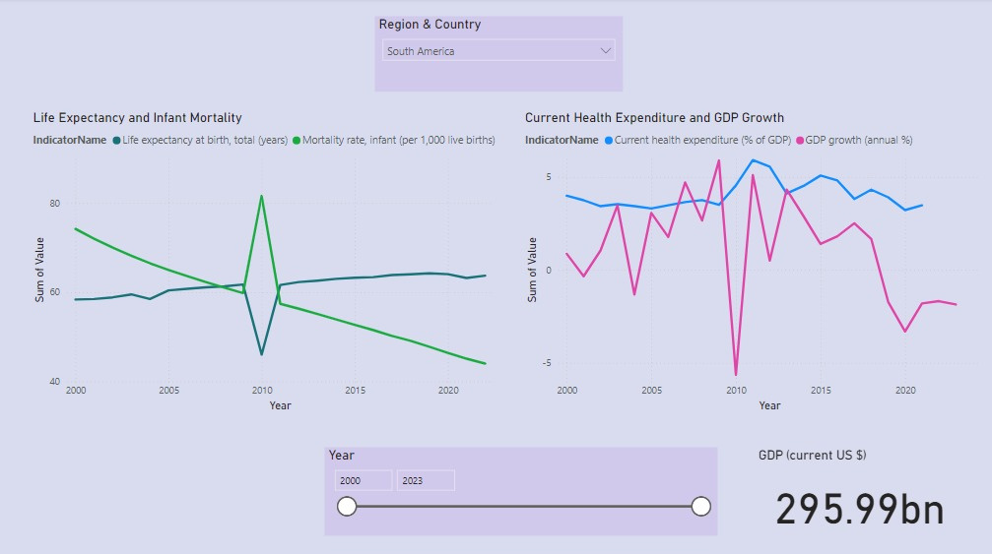
South America
18
Infant Mortality: Significant decline with a spike in 2010.
Health Expenditure: Stable with slight functions in the later period.
Health Expenditure: Clear trend that increased health expenditure is linked to improved health outcomes.

Slide 19
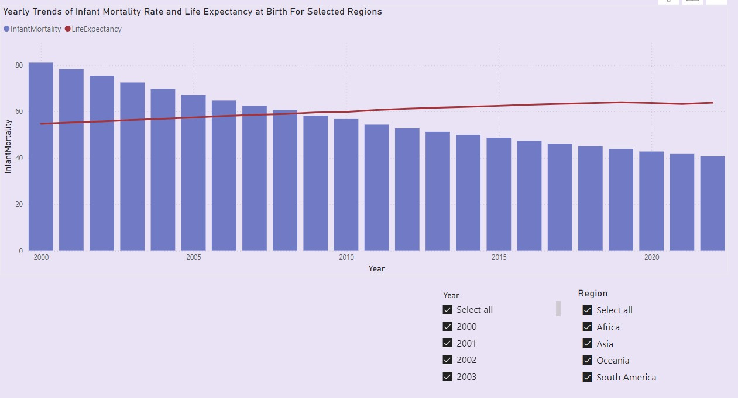
Yearly trends of Infant Mortality and Life Expectancy
19
Infant Mortality: shows consistent decline from 2000 to 2022.
Life expectancy: shows a gradual upward trend.

Slide 20
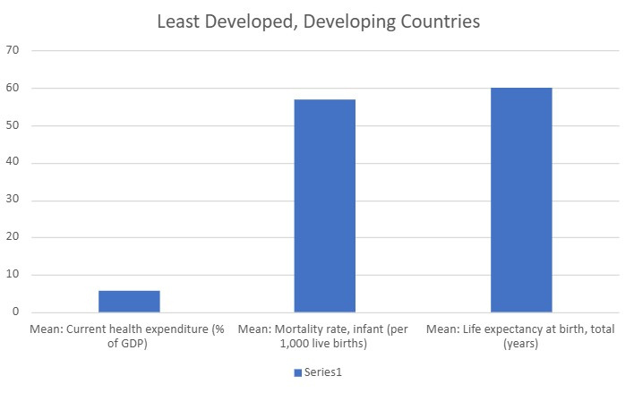
20
Health expenditure: Mean health expenditure as a percentage of GDP is 5.63% .
Infant Mortality Rate: average IMR is 57 deaths per 1,000 live births.
Life expectancy: mean life expectancy is 60.19 years which is significantly low.

Slide 21
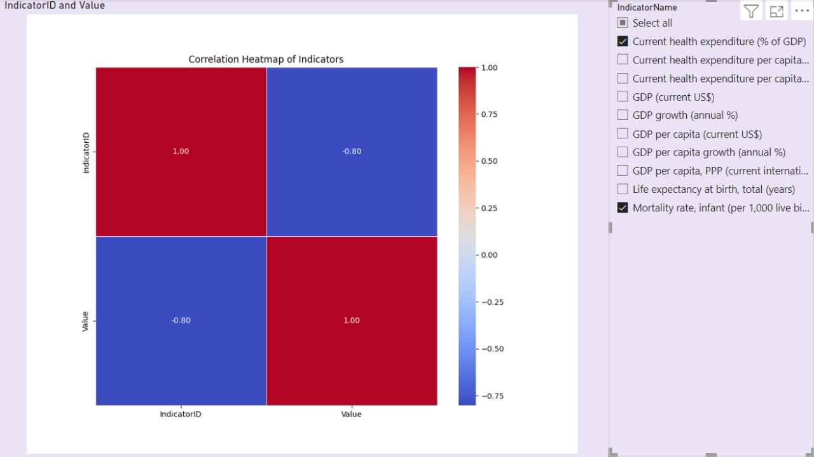
Heatmap of Current health expenditure and mortality rate
21
The Heatmap shows a negative correlation of -0.80 between current health expenditure (% of GDP) and infant mortality rate (per 1,000 live births).

Slide 22
22
CONCLUSION
Research Question: Correlation between mortality rates and health expenditure confirmed.
Hypothesis: Inverse relationship validated.
Key Findings: Higher health spending → Lower mortality rates
Trends: 23 years show consistent mortality reduction with increased health investment.
Implications: Prioritize health spending for better outcomes

Slide 23

REFERENCES
23
[1] “Health Expenditure, Institutional Quality, and Under-Five Mortality in Sub-Saharan African Countries”
[2] “Health expenditure, longevity, and child mortality: dynamic panel data approach with global data”
[3] “Health expenditures, health outcomes and the role of good governance”
[4] “Health, inequality, and income: a global study using simultaneous model”
[5] "The effect of private and public health expenditure on infant mortality rates: Does the level of development matter?"
[6] “Effect of Health Care Expenditures on Child Mortality Rates: A Case Study of Sub-Saharan Africa”
[7] “Health expenditure, child and maternal mortality nexus: a comparative global analysis”
[8] “Relationship between mortality and health care expenditure: Sustainable assessment of health care system”
[9] “The Determinants of Infant Mortality in the Less Developed Countries: A Cross-National Test of Five Theories”
[10] “The Effect of Health Expenditure on Life Expectancy”
[11] “The relationship between health care expenditure and health outcomes”
[12] “Social, Demographic and Economic Determinants of Health Status in Pakistan: A time series analysis”
[13] “Global Health Economics: Shaping Health Policy in Low- and Middle-Income Countries”
[14] UNCTAD, “UN List of Least Developed Countries”

